Slide 1

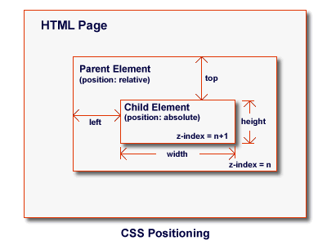


CSS Presentation and Positioning
CSS Fonts, Borders, Backgrounds, Positioning
CSS Presentation and Positioning
SoftUni Team
Technical Trainers
Software University
http://softuni.bg

Slide 2

Table of Contents
CSS Fonts
Font Rules – Color, Font-family, Font-style…
Text Shadow –
Word Wrap –
CSS Borders
Margins and Paddings
Border and Content Box
CSS Positioning
Float and Clear
p { text-shadow: 2px 2px 7px #000; }
p { word-wrap:break-word; }

Slide 3

Have a Question?
sli.do #web-basics

Slide 4
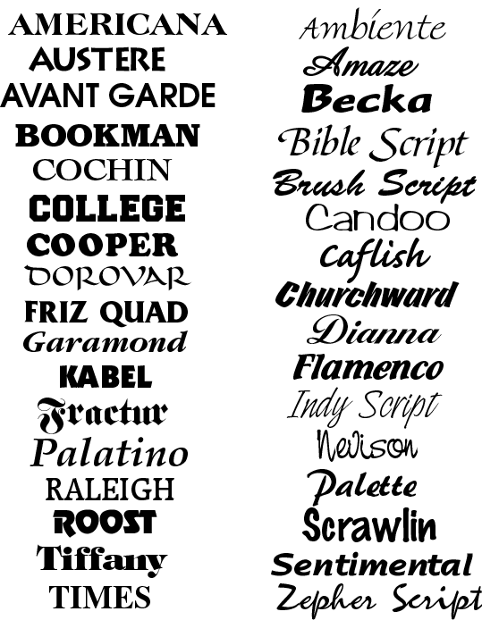




CSS Font / Text Properties
CSS Text

Slide 5
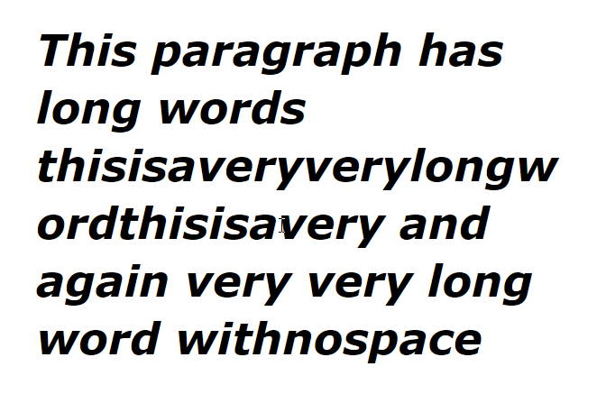
Font Property
CSS font property
font: italic normal bold 12px/16px Verdana
font-style: italic;
font-variant: normal;
font-weight: bold;
font-size: 12px;
line-height: 16px;
font-family: Verdana;

Slide 6
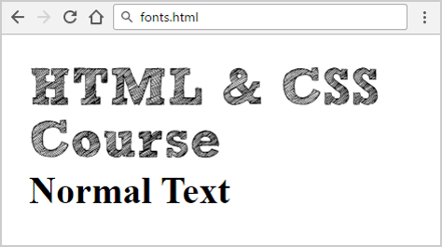
Font Embedding
<h1>HTML & CSS Course</h1>
<h2>Normal Text</h2>
@font-face {
font-family: SketchRockwell;
src: url('fonts/SketchRockwell.ttf')
}
h1 {
font-family: SketchRockwell;
font-size: 3.5em
}

Slide 7
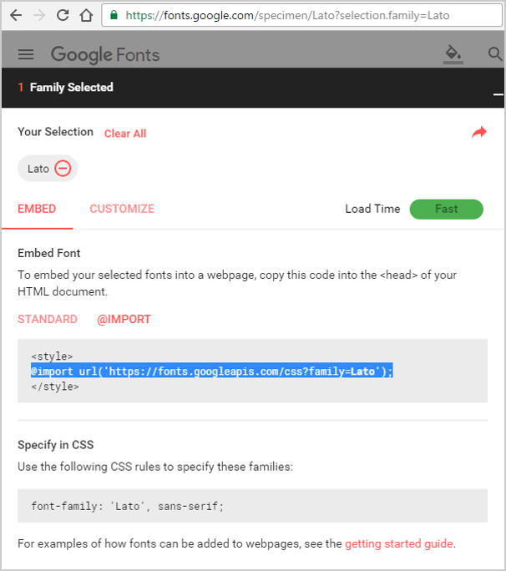

Importing "Lato" from Google Font Directory
@import url('https://fonts.googleapis.com/css?family=Lato');
body {
font-family:
Lato, Arial, sans-serif;
}
serif font
sans-serif font

Slide 8
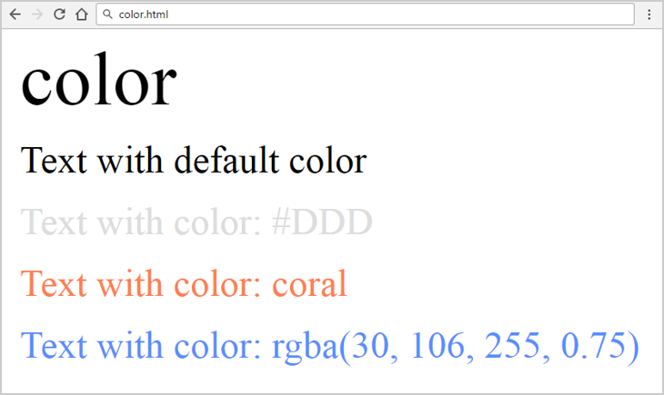
CSS Font Rules: Color
<h1>color</h1>
<p>Text with default color</p>
<p class="color-ddd">Text…</p>
<p class="color-coral">Text…</p>
<p class="color-rgba">Text…</p>
.color-ddd {
color:#DDD;
}
.color-coral {
color:coral;
}
.color-rgba {
color:
rgba(30, 106, 255, 0.75)
}

Slide 9
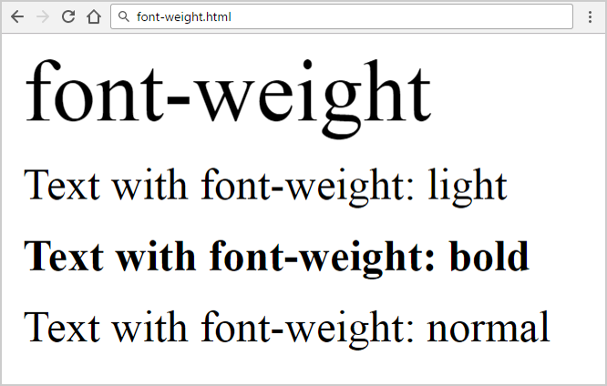
CSS Font Rules: Font-Weight
<p class="weight-light">Text…</p>
<p class="weight-bold">Text…</p>
.weight-light {
font-weight: light;
}
.weight-bold {
font-weight: bold;
}
Check more font-weight: https://css-tricks.com/almanac/properties/f/font-weight/

Slide 10
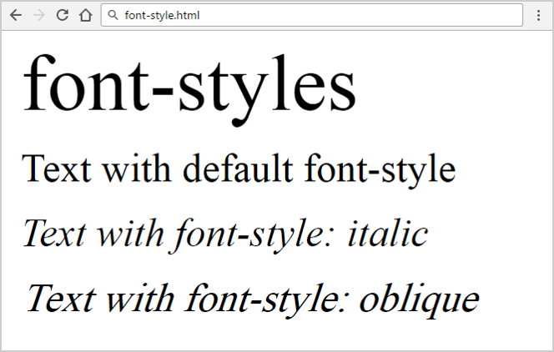
CSS Font Rules: Font-Style
<p class="font-style-italic">Text…</p>
<p class="font-style-oblique">Text…</p>
.font-style-italic {
font-style: italic;
}
.font-style-oblique {
font-style: oblique;
}
Check more font-style: https://css-tricks.com/almanac/properties/f/font-style/

Slide 11
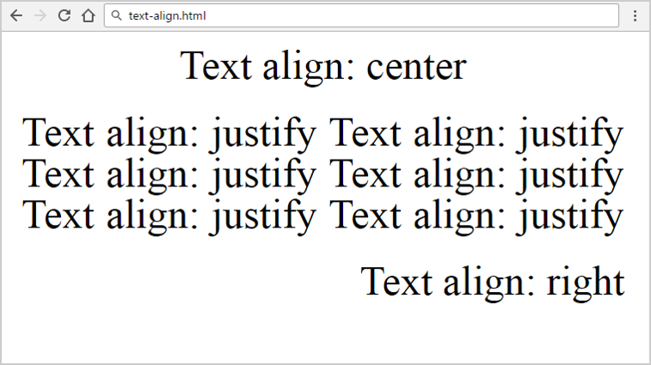
CSS Font Rules: Text-Align
<p class="text-align-center">Text…</p>
<p class="text-align-justify">Text…</p>
.text-align-center {
text-align: center;
}
.text-align-justify {
text-align: justify;
}
Check more text-align: https://css-tricks.com/almanac/properties/t/text-align/

Slide 12
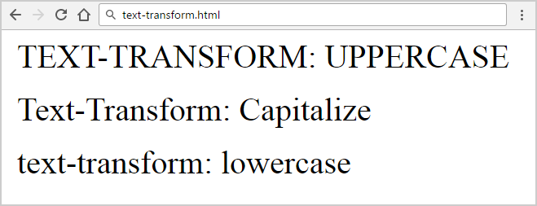
CSS Font Rules: Text-Transform
<p class="uppercase">Text…</p>
<p class="capitalize">Text…</p>
.uppercase {
text-transform: uppercase;
}
.capitalize {
text-transform: capitalize;
}
Check more text-transform: https://css-tricks.com/almanac/properties/t/text-transform/

Slide 13
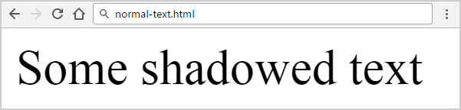
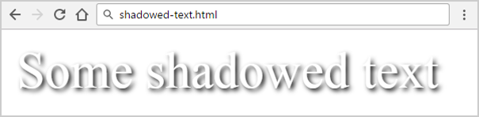
Text Shadow
<blur radius>
<shadow
color>
p {
text-shadow: 2px 2px 7px #000; }
<horizontal
distance>
<vertical
distance>

Slide 14
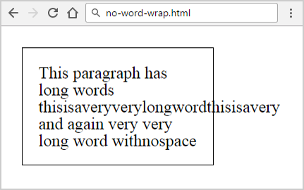
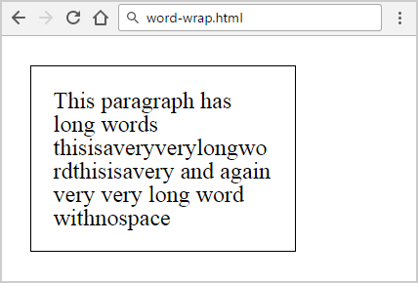
Word Wrapping
<p>This paragraph…</p>
p {
word-wrap: normal;
}
p {
word-wrap: break-word;
}

Slide 15
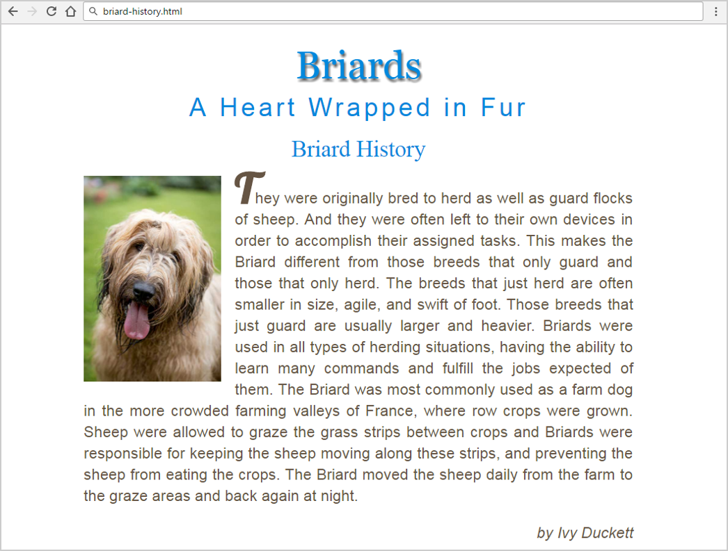
Problem: Briard History

Slide 16

Solution: Briard History (HTML)
<main>
<h1>Briards</h1>
<h2>A Heart wrapped <span>in</span> fur</h2> <article>
<header>
<h3><a class="breed" href="https://en.wikipedia.org/wiki/Briard"> Briard History</a></h3>
</header>
<img src="briard.jpg" alt="briard">
<p><!—TODO put the text here…--></p>
<p class="credits">by Ivy Duckett</p>
</article>
</main>
Check your solution here: https://judge.softuni.bg/Contests/406/

Slide 17
Solution: Briard History (CSS)
@import url("https://fonts.googleapis.com/css?family=Lobster");
html { font-size: 16px; }
main {
margin: 0 auto;
width: 800px;
padding: 20px; }
h1, h2, h3, a {
font-weight: normal;
color: #0088dd;
margin: 0;
text-align: center;
font-size: 2.1rem;
text-decoration: none; }
h1 {
font-family: Georgia,Times,serif;
font-size: 3.5em;
text-shadow: 2px 4px 4px #666666;
padding-bottom: 10px;
text-transform: capitalize; }
h2 {
font-family: Arial,sans-serif;
font-size: 2.3rem;
text-transform: capitalize;
letter-spacing: 0.3rem }
h2 span {
text-transform: none; }

Slide 18
Solution: Briard History (More CSS)
article {
margin-top: 20px;
text-align: justify; }
p {
font-family: Arial, Verdana, sans-serif;
line-height: 30px;
color: #665544;
font-size: 1.4rem;
}
.credits {
font-style: italic;
text-align: right;
}
header {
margin-bottom: 20px;
}
img {
width: 200px;
float: left;
margin-right: 20px;
}
p:first-of-type:first-letter {
font-weight: bold;
font-size: 3.8rem;
font-family: 'Lobster', cursive;
text-transform: uppercase;
}

Slide 19
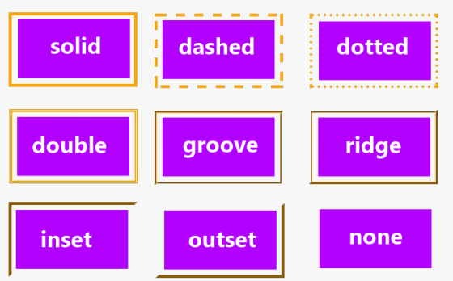
CSS Borders

Slide 20
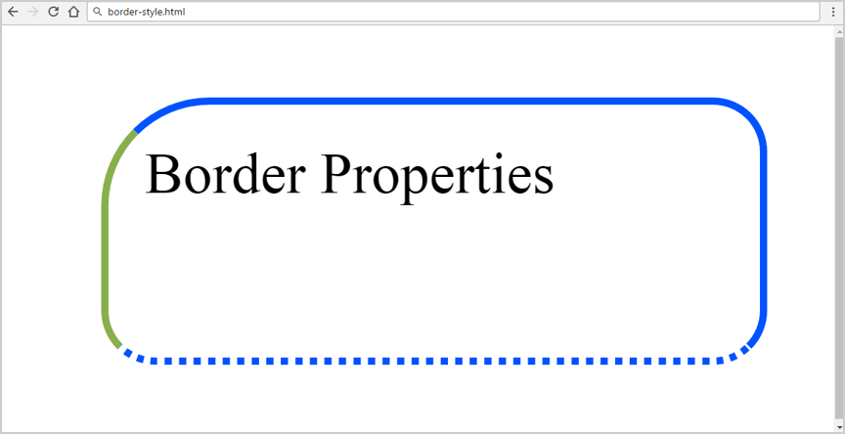
Border Properties
div {
width: 160px;
height: 50px;
border-width: 2px;
border-style: solid;
border-color: #0053ff;
border-radius: 15px;
border-top-left-radius: 30px;
border-bottom-style: dotted;
border-left-color: #89AF4C;
}

Slide 21
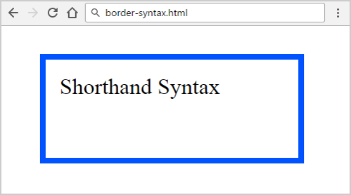
Border Shorthand Property
<div>Short Syntax</div>
border-width
border-style
div {
border: 4px solid #0053ff;
width: 160px;
height: 50px;
}
border-color

Slide 22
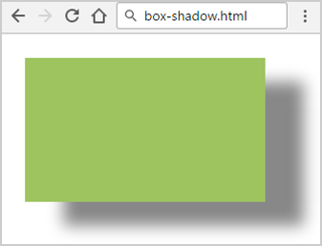
Box Shadow
.box {
margin: 5px;
width: 50px;
height: 30px;
background: #9DC45F;
box-shadow: 8px 5px 5px #888;
}
blur
color
offset-x
offset-y

Slide 23
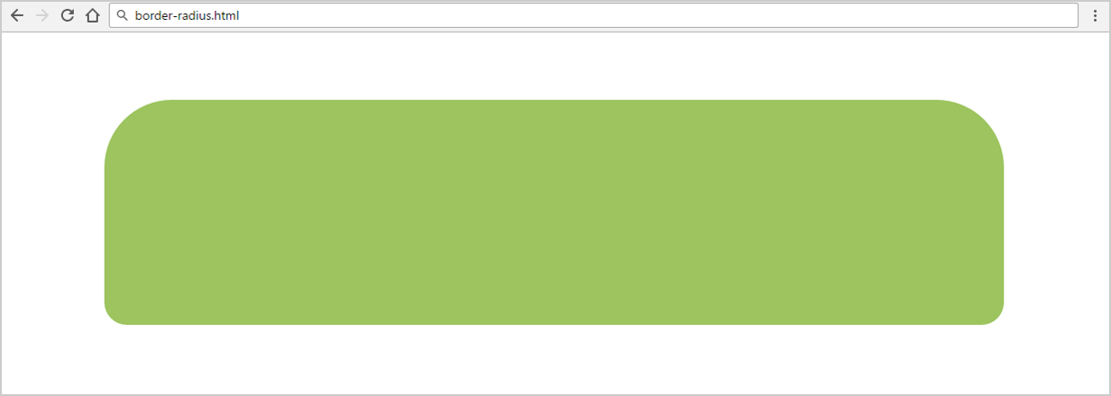
Border Radius
top-left
top-right
.rounded {
border-radius: 15px 15px 5px 5px;
}
bottom-right
bottom-left

Slide 24

CSS Background Properties

Slide 25
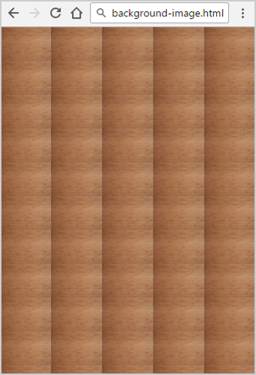
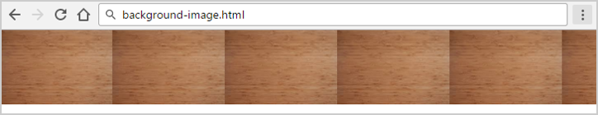
Background (Background-Image)
body {
background-image: url(img/bgr.png);
background-repeat: repeat;
background-repeat: repeat-x;
background-repeat: repeat-y;
background-repeat: no-repeat;
}
repeat
repeat-x

Slide 26
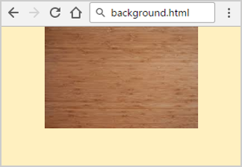
Background Shorthand Property
background-color
background-image
background-repeat
body {
background: #FFF0C0 url(img.jpg) no-repeat fixed top;
}
background-attachment
background-position

Slide 27
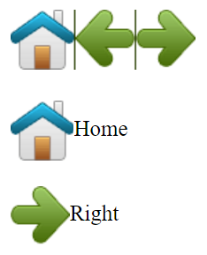
CSS Sprites: Multiple Images in a Single File
<img src="img_navsprites.gif"><br><br>
<img id="home" src="img_trans.gif">Home<br><br>
<img id="next" src="img_trans.gif">Right
#home {
width: 46px; height: 44px;
background: url(img_navsprites.gif) 0 0;
vertical-align: middle; }
#next {
width: 43px;
background: url(img_navsprites.gif) -91px 0;
vertical-align: middle; }
Use negative value: move left by 91px

Slide 28
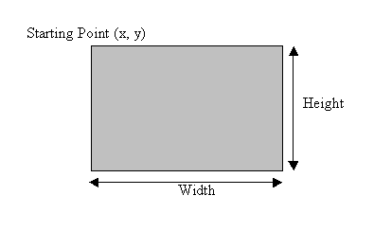
Width and Height

Slide 29
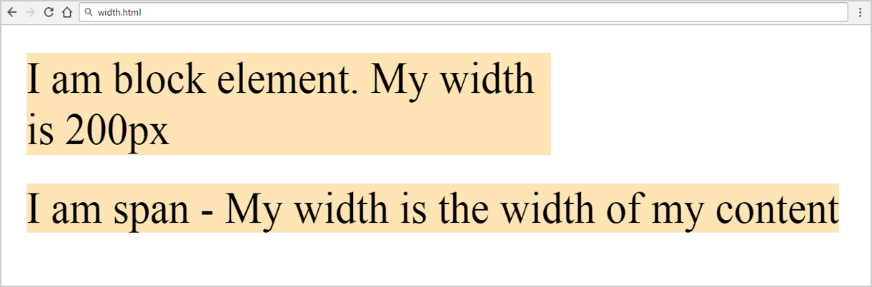
Width, Max-Width, Min-Width
Block elements have width / height
Inline elements don't have
p {
width: 50%;
min-width: 120px;
max-width: 220px;
}
div, span { width: 200px; }
<div>
I am block …
</div>
<span>
I am span …
</span>

Slide 30
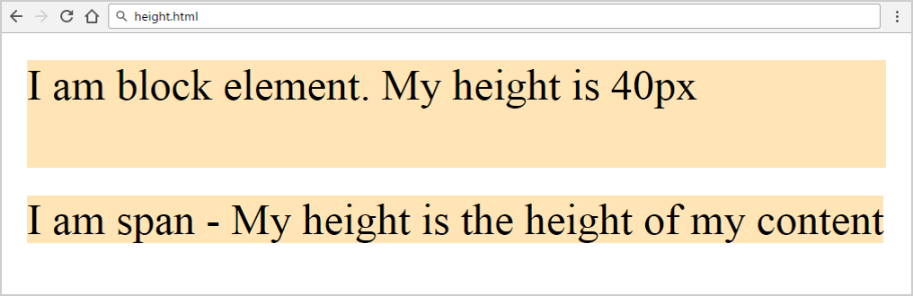
Height, Min-Height, Max-Height
p {
height: 50%;
min-height: 50px;
max-height: 100px;
}
Block elements have width / height
Inline elements don't have
div, span { height: 40px; }
<div>
I am block …
</div>
<span>
I am span …
</span>

Slide 31
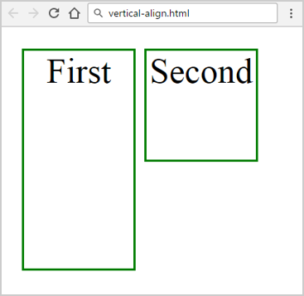
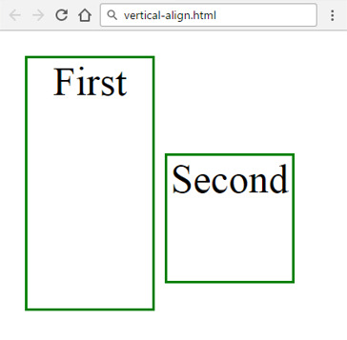
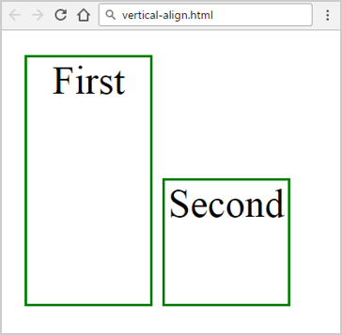
Inline-Block Elements: Vertical-Align
top
middle
bottom
.boxes li {
display: inline-block;
text-align: center;
width: 50px;
border: 1px solid green;
}
.boxes li:nth-child(1) {
height: 100px;
vertical-align: top;
}
.boxes li:nth-child(2) {
height: 50px; }

Slide 32
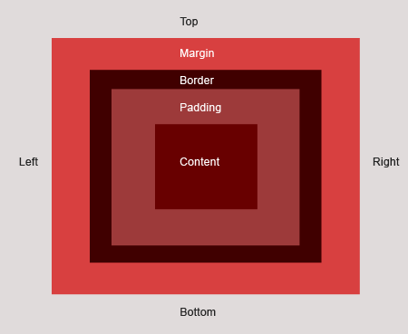
Margins and Paddings

Slide 33
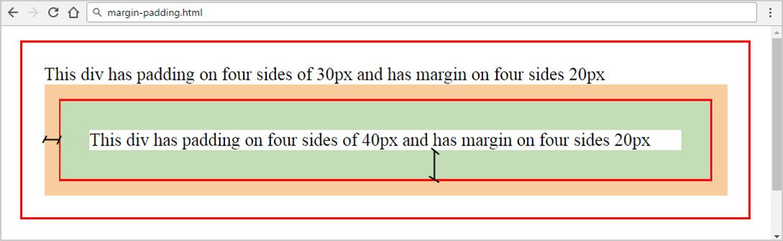
Margins and Paddings
margin
padding
margin-top
margin-right
margin-bottom
div { margin: 20px 20px 20px 20px
padding: 30px 30px 30px 30px }
margin-left

Slide 34
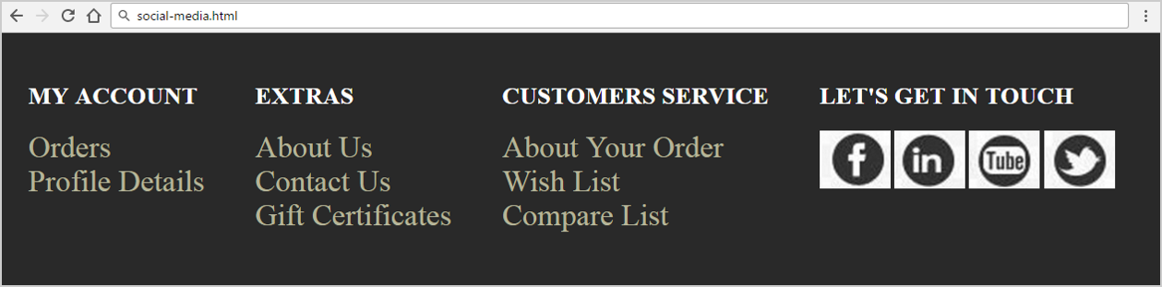
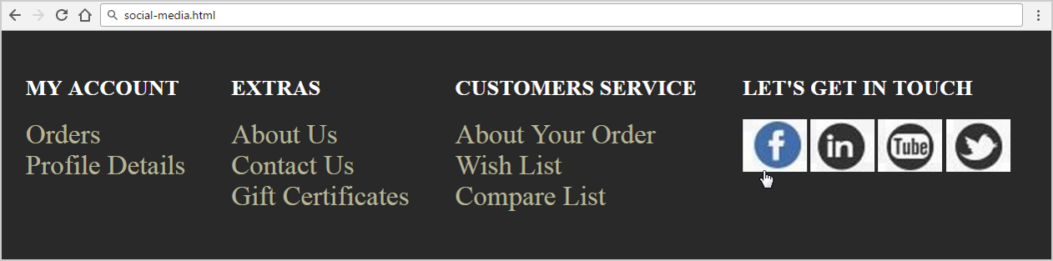
Problem: Social Media

Slide 35
Solution: Social Media – HTML
<footer>
<section>
<h2>my account</h2>
<ul>
<li><a href="#">orders</a></li>
<li><a href="#">profile details</a></li>
</ul>
</section>
<!-- TODO: put the rest <section> here -->
<!-- TODO: put the rest <ul> here -->
<!-- TODO: put the rest <li> here -->

Slide 36
Solution: Social Media – HTML (2)
<section>
<h2>let's get in touch</h2>
<div>
<div class="facebook"><a href="#"></a></div>
<div class="linkedin"><a href="#"></a></div>
<div class="youtube"><a href="#"></a></div>
<div class="twitter"><a href="#"></a></div>
</div>
</section>
</footer>
Check your solution here: https://judge.softuni.bg/Contests/406/

Slide 37
Solution: Social Media – CSS
ul, li, div, section, a {
margin: 0;
padding: 0; }
body {
background: rgb(41, 41, 41); }
footer {
height: 150px;
margin: 0 auto; }
h2 {
text-transform: uppercase; }
section {
float: left;
margin-left: 10px;
padding: 20px;
height: 150px;
color: #ffffff;
}
ul {
list-style: none;
}
a {
text-decoration: none;
color: rgb(181, 180, 152);
font-size: 30px;
text-transform: capitalize;
}

Slide 38
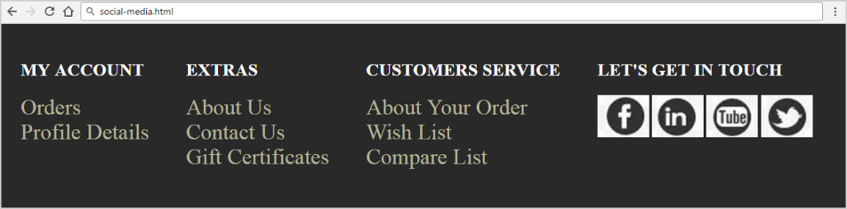
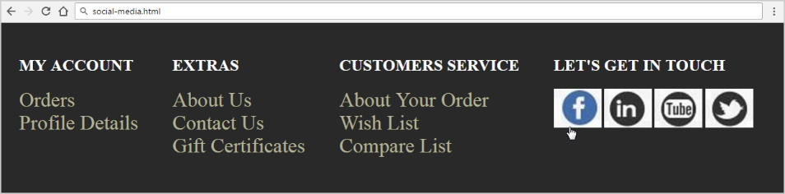
Solution: Social Media – CSS (2)
footer > section > div div {
width: 70px;
height: 58px;
background: url("images/social.jpg");
display: inline-block; }
.twitter { background-position: 772px 126px; }
.linkedin { background-position: 642px 126px; }
.youtube { background-position: 325px 126px; }
.facebook, .twitter, .youtube, .linkedin { cursor: pointer; }
.facebook:hover { background-position: 0 60px; }
.linkedin:hover { background-position: 642px 63px; }
.youtube:hover { background-position: 325px 63px; }
.twitter:hover { background-position: -66px 63px; }

Slide 39
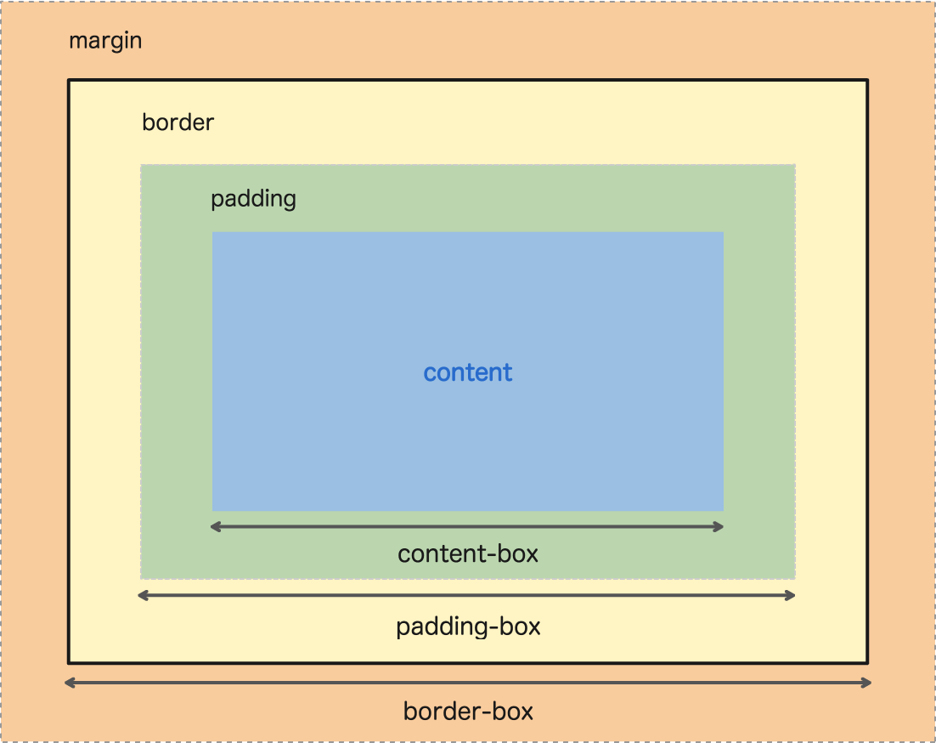
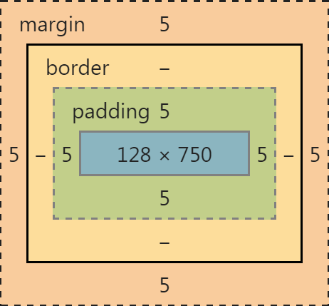
Border Box and Content Box

Slide 40
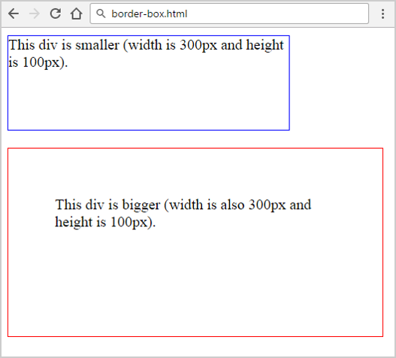
CSS Box-Sizing: Content-Box
<div class="div1">This div is smaller…</div>
<div class="div2">This div is bigger…</div>
.div1 {
width: 300px;
height: 100px;
border: 1px solid blue; }
.div2 {
width: 300px;
height: 100px;
padding: 50px;
border: 1px solid blue;
}

Slide 41
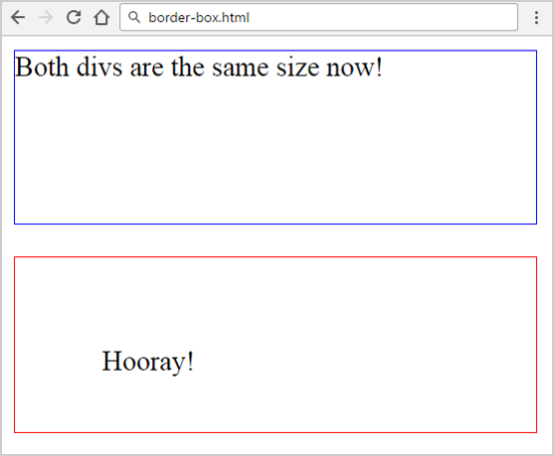
CSS Box-Sizing: Border-Box
<div class="div1">Both divs…</div>
<div class="div2">Hooray!</div>
* { box-sizing: border-box; }
.div1 {
width: 300px;
height: 100px;
border: 1px solid blue; }
.div2 {
width: 300px;
height: 100px;
padding: 50px;
border: 1px solid blue; }

Slide 42
CSS Positioning
Positioning of the HTML Elements

Slide 43
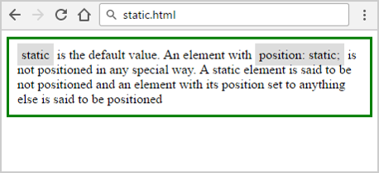
Positioning: Static
<div class="static">
static is the default value…
</div>
.static {
position: static;
border: 3px solid green;
padding: 10px;
}

Slide 44
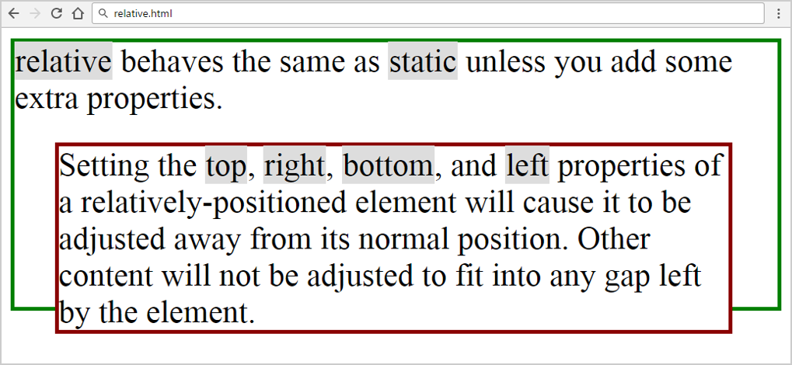
Positioning: Relative
<div class="relative1">
relative behaves …
<div class="relative2">
Setting the top…
</div>
</div>
.relative1 {
position: relative;
}
.relative2 {
position: relative;
top: 20px; left: 30px; }

Slide 45
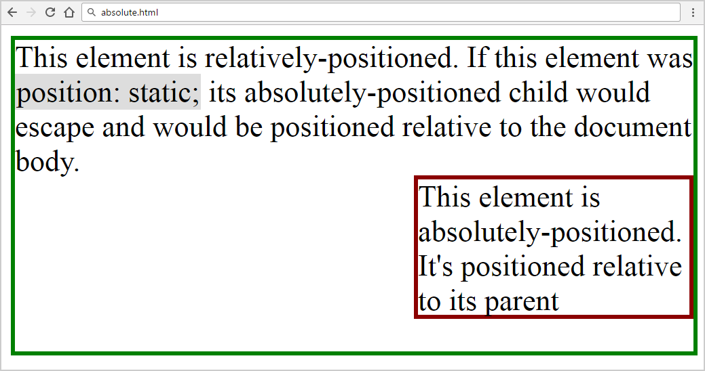
Positioning: Absolute
<div class="relative">
This element is relatively…
<div class="absolute">
This element is…
</div>
</div>
.relative {
position: relative;
}
.absolute {
position: absolute;
top: 100px; right: 0; }

Slide 46
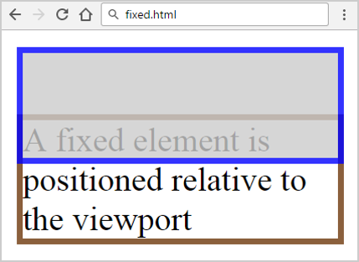
Positioning: Fixed
.fixed {
position: fixed;
top: 40px;
background: white;
width: 150px;
border: 3px solid #8b603d; }
.div {
background: #CCCCCC;
opacity: 0.8;
width: 150px;
height: 50px;
border: 3px solid #0000FF;
}
<div class="fixed">
A fixed element is positioned…
</div>
<div class="div"></div>

Slide 47
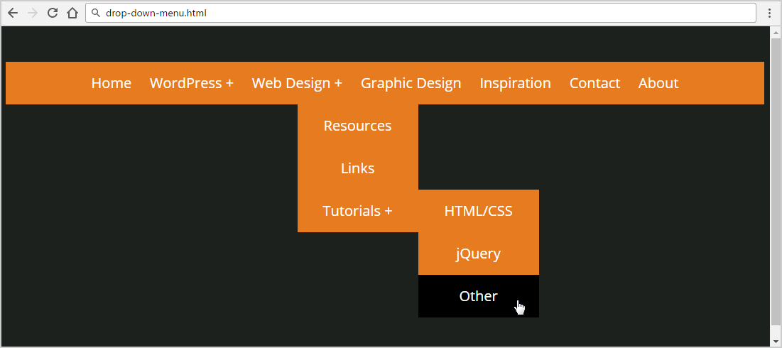
Problem: Drop Down Menu
Create a Web page (HTML + CSS) like at the screenshot:
Check your solution here: https://judge.softuni.bg/Contests/406/

Slide 48
Solution: Drop Down Menu (HTML)
<nav>
<ul>
<li><a href="#">Home</a></li>
<!-- TODO: put the rest list item here-->
<li><a href="#">Web Design</a>
<ul>
<!-- TODO: put the rest list item here-->
<li><a href="#">Tutorials</a>
<ul><!-- TODO: put the rest list item here--></ul>
</li>
</ul>
</li><!-- TODO: put the rest list item here-->
</ul>
</nav>

Slide 49
Solution: Drop Down Menu (CSS)
@import url(http://fonts.googleapis.com/css?family=Open+Sans);
body {
font-family: 'Open Sans', sans-serif;
background: #1d211e;
font-size: 22px;
line-height: 22px;
color: #ffffff;
text-align: center; }
a {
color: #ffffff; }
nav {
margin: 50px 0;
background-color: #e67c1f; }
nav ul {
padding: 0;
margin: 0;
list-style: none;
position: relative;
}
nav ul li {
display: inline-block;
background-color: #e67c1f;
}

Slide 50
Solution: Drop Down Menu (More CSS)
nav a {
display: block;
padding: 0 10px;
color: #FFF;
font-size:20px;
line-height: 60px;
text-decoration: none; }
nav a:hover {
background-color: #000000;
}
nav ul ul {
display: none;
position: absolute; }
nav ul li:hover > ul {
display: inline-block; }
nav ul ul li {
width: 170px;
position: relative;
display: block; }
nav ul ul ul li {
position: relative;
top: -60px;
left: 85px; }
li > a::after { content:' +'; }
li > a:only-child::after {
content:''; }

Slide 51
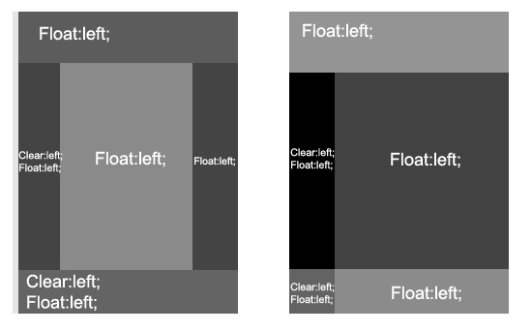
Floating Elements

Slide 52
Floating Elements
HTML elements can float left and right
float:left
float:right
no floating block
Some text around …
<div style= "float:left">
float:left
</div>
Some text before …
<div style= "margin:0 auto">
no floating block
</div>
Some text around …
<div style= "float:right">
float:left
</div>

Slide 53
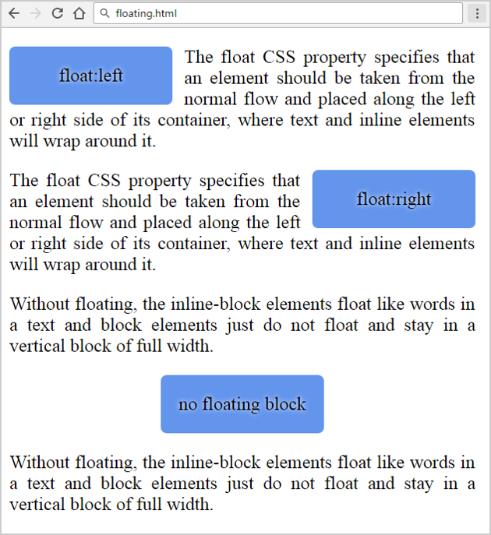
Problem: Floating Elements (HTML)
Create a Web page (HTML + CSS) like at the screenshot:
<main>
<div class="left">left</div>
<p>The float CSS property …</p>
<div class="right">right</div>
<p>The float CSS property …</p>
<p>Without floating …</p>
<div class="center">no float</div>
<p>Without floating …</p>
</main>
Check your solution here: https://judge.softuni.bg/Contests/406/

Slide 54
Solution: Floating Elements (CSS)
main { width: 400px;
text-align: justify; }
.left, .right, .center {
width: 120px; height: 30px;
line-height: 30px;
text-align: center;
padding: 10px;
background: CornflowerBlue;
border-radius: 5px;
text-shadow: 0px 0px 5px white; }
.left {
float: left;
margin-right: 10px;
}
.right {
float: right;
margin-left: 10px;
}
.center {
margin: 0 auto;
}

Slide 55
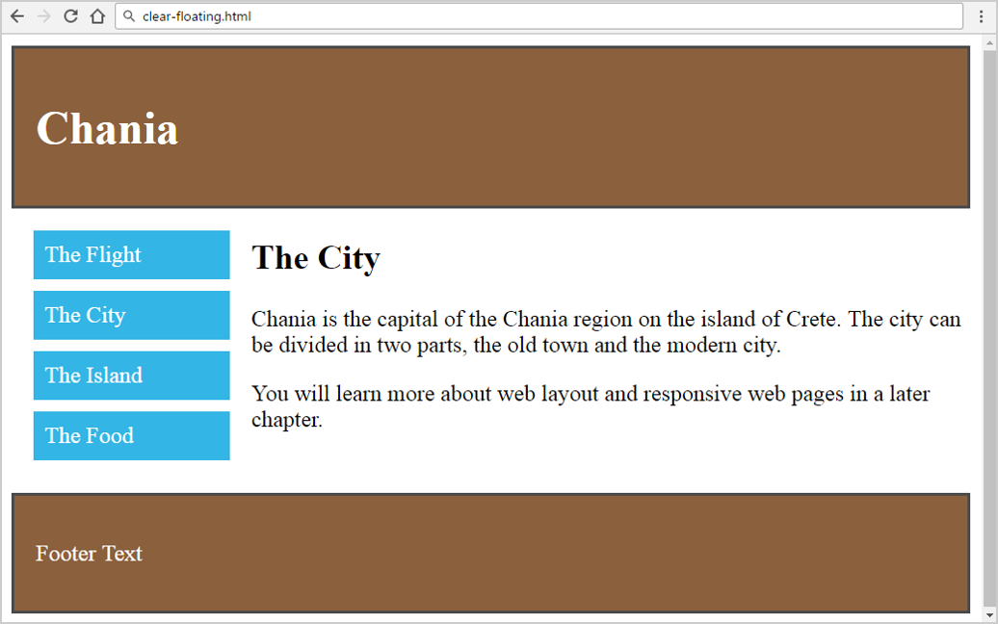
Problem: Clear Floating
You are given the HTML for this page. Write the missing CSS. Use left floating, right floating and clearing

Slide 56
Solution: Clear Floating (HTML)
<header>
<h1>Chania</h1>
</header>
<main class="clearfix">
<aside class="float-left menu">
<ul>
<li>The Flight</li>
<li>The City</li>
<li>The Island</li>
<li>The Food</li>
</ul>
</aside>
Check your solution here: https://judge.softuni.bg/Contests/406/

Slide 57
Solution: Clear Floating (HTML)
<article class="float-right content">
<h2>The City</h2>
<p>Chania is the capital of the Chania…</p>
<p>You will learn more about web layout…</p>
</article>
</main>
<footer>
<p>Footer Text</p>
</footer>

Slide 58
Solution: Clear Floating (CSS)
* { box-sizing: border-box; }
header, footer {
background: #8b603d;
color: white;
padding: 15px;
border: 2px solid #4B4B4B; }
.menu { width: 25%; }
.float-left {
float: left;
padding: 15px; }
.float-right { float: right; }
.content { width: 75%; }
.menu ul {
list-style-type: none;
margin: 0;
padding: 0; }
.menu li {
padding: 8px;
margin-bottom: 8px;
background: #33b5e5;
color: #ffffff; }
.clearfix::after {
content: "";
display: block;
clear: both; height: 0; }

Slide 59
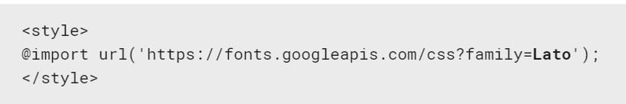

Summary
Font
Borders:
Margins and Paddings
CSS Positioning
Float and Clear
@font-face {font-family: Lato;}
div {border: 4px solid #0053ff;}
.left { float: left; }
.clearfix{ clear: left; }

Slide 60








CSS Presentation and Positioning
https://softuni.bg/courses/web-fundamentals-html5

Slide 61
License
This course (slides, examples, demos, videos, homework, etc.) is licensed under the "Creative Commons Attribution-NonCommercial-ShareAlike 4.0 International" license

Slide 62




Free Trainings @ Software University
Software University – High-Quality Education, Profession and Job for Software Developers
softuni.bg
Software University Foundation
softuni.org
Software University @ Facebook
facebook.com/SoftwareUniversity
Software University Forums
softuni.bg/forum

